Slide 1
Working Securely and Efficiently –Remotely

Slide 2

Background
Joy Beland, SSAP, Security+, CSX Fundamentals​
Senior Cybersecurity Education Director

Slide 3
What every employee must know about the
vulnerabilities of working outside the company network,
and your role in protecting the company.

Slide 4

Why We’re Here
Remote Workers Normally Make Up Only 3.2% of Our Entire Workforce. 44% of Companies Don’t Allow Remote Work at All
Natural Disasters, Sick Dependents, State of Emergencies Happen. But Today’s COVID-19 Scenario is Unprecedented.
Your IT Provider Wants Your Cybersecurity Culture to Transcend the Office Walls:
  Protect Your Family
  Protect Your Data

Slide 5

Agenda
Maintaining Control of Company Data Assets - WHY This is Important and WHO It’s Happening To
Threat Vectors – HOW The Bad Guys Get In
Your Role – WHAT You Can Do to Protect Yourself, Your Family, and Your Data

Slide 6
Maintaining Control of Company Data Assets
Why is this important? Who is this happening to?
Notes:
Like Simon Sinek says, let’s start with the WHY.

Slide 7
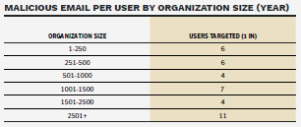
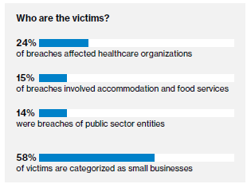
Why Small Businesses are Prime Targets
Budget – SMB’s Spend 10% Of Their Annual Budget On IT (Including Support). They Can’t Afford A $40,000 Firewall And CISO On Staff.
Low IT Skill Level or No Support Unless Something Breaks
Aging Equipment And Unpatched Devices
Owners Wear Many Hats and Don’t Focus On Security
SMB’s Don’t Believe it Will Happen to Them
SMB’s Believe Their Data is Not Valuable
SMB’s Far Behind Enterprise in Educating Employees
Source: Symantec 2019 Internet Threat Report
Source: Verizon 2018 DBIR Report
Notes:
Why are small businesses prime targets? Let’s look at some of the more obvious reasons like the small budget they have for protecting themselves. Or the fact that a lot of the very small businesses I know, have someone that is computer savvy managing their network – but not necessarily skilled in cybersecurity. Or they have old computers and haven’t kept up with patching them properly. Most importantly, a lot of small businesses just don’t believe that a breach will happen to them, that their data would be valuable to a hacker, or that training their employees on how to use their computers securely is something they need to do. (CLICK) but let’s look at the reality of most email phishing campaigns that are deployed in a manner that we call “casting a wide net.” Hackers will try to infect thousands of random victims at a time, not being discriminate on the size of their company. When you look at the ratio of infected emails targeting users, to the size of the company, you can see that a company with less than 250 employees receives 50% of the amount of infected emails targeting users of companies that are over 2500 in size. And, of all victims of cybercrime, 58% of them were classified as small businesses in 2018. That number rose up to over 60% in 2019.

Slide 8
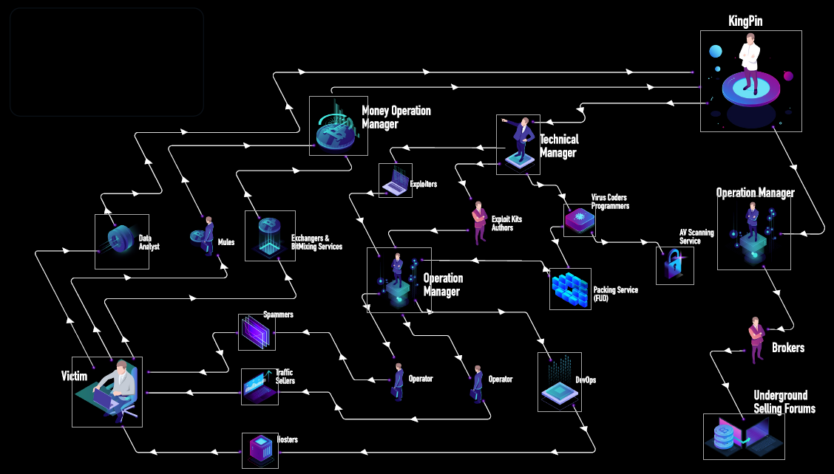
What Organized Crime Looks Like
CEO or President?
CFO?
CTO?
COO?
Customer?
Source: Check Point Research, RSA presentation 2019

Slide 9
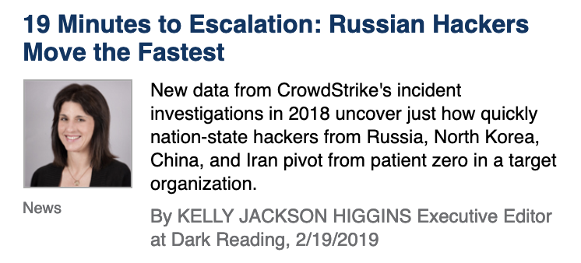
Cybercrime on the Dark Web
Stolen Credentials Are Used to Test for Open Door Access Into Corporate Networks
197 Days: The Average Length of Time it Takes for Organizations to Identify a Data Breach
Stolen Credentials Are Sold Here
Notes:
What most of us see is that top 4% of the web. Walk through what is in deep web vs. dark web, and why stolen creds being sold on dark web are so time sensitive, in how they are used to attempt login to the sites seen at the top 4% of the web. Talk about how fast Russian hackers can now get into networks.

Slide 10
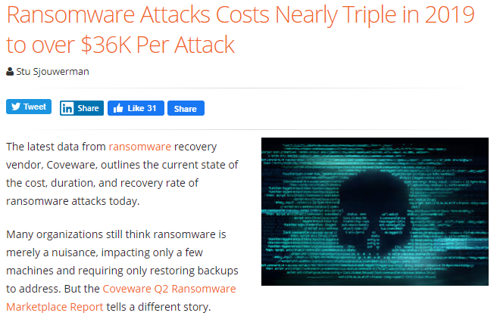
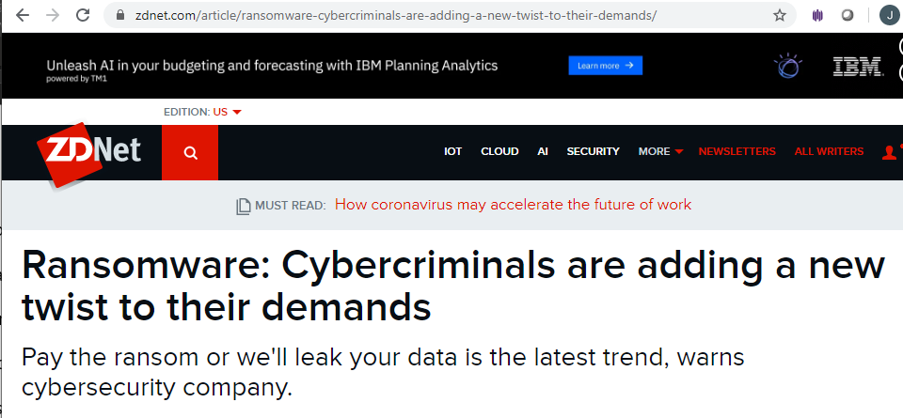
Cybercrime on the Dark Web
Notes:
Even if your company has insurance, a cyber breach is very costly when you account for the downtime, reputation, brand, lost revenue, and everything else. The average cost was $36,000 in 2019. (CLICK) and now, there’s a new spin to the cyber crime. You saw in the previous slide, most hackers spend six months on a network once they get in. Do you think they are not going to get paid for that time? Even if you have a good backup system to restore from, the new twist is to demand a ransom and if it’s not going to be paid, then to sell the data on the dark web.

Slide 11
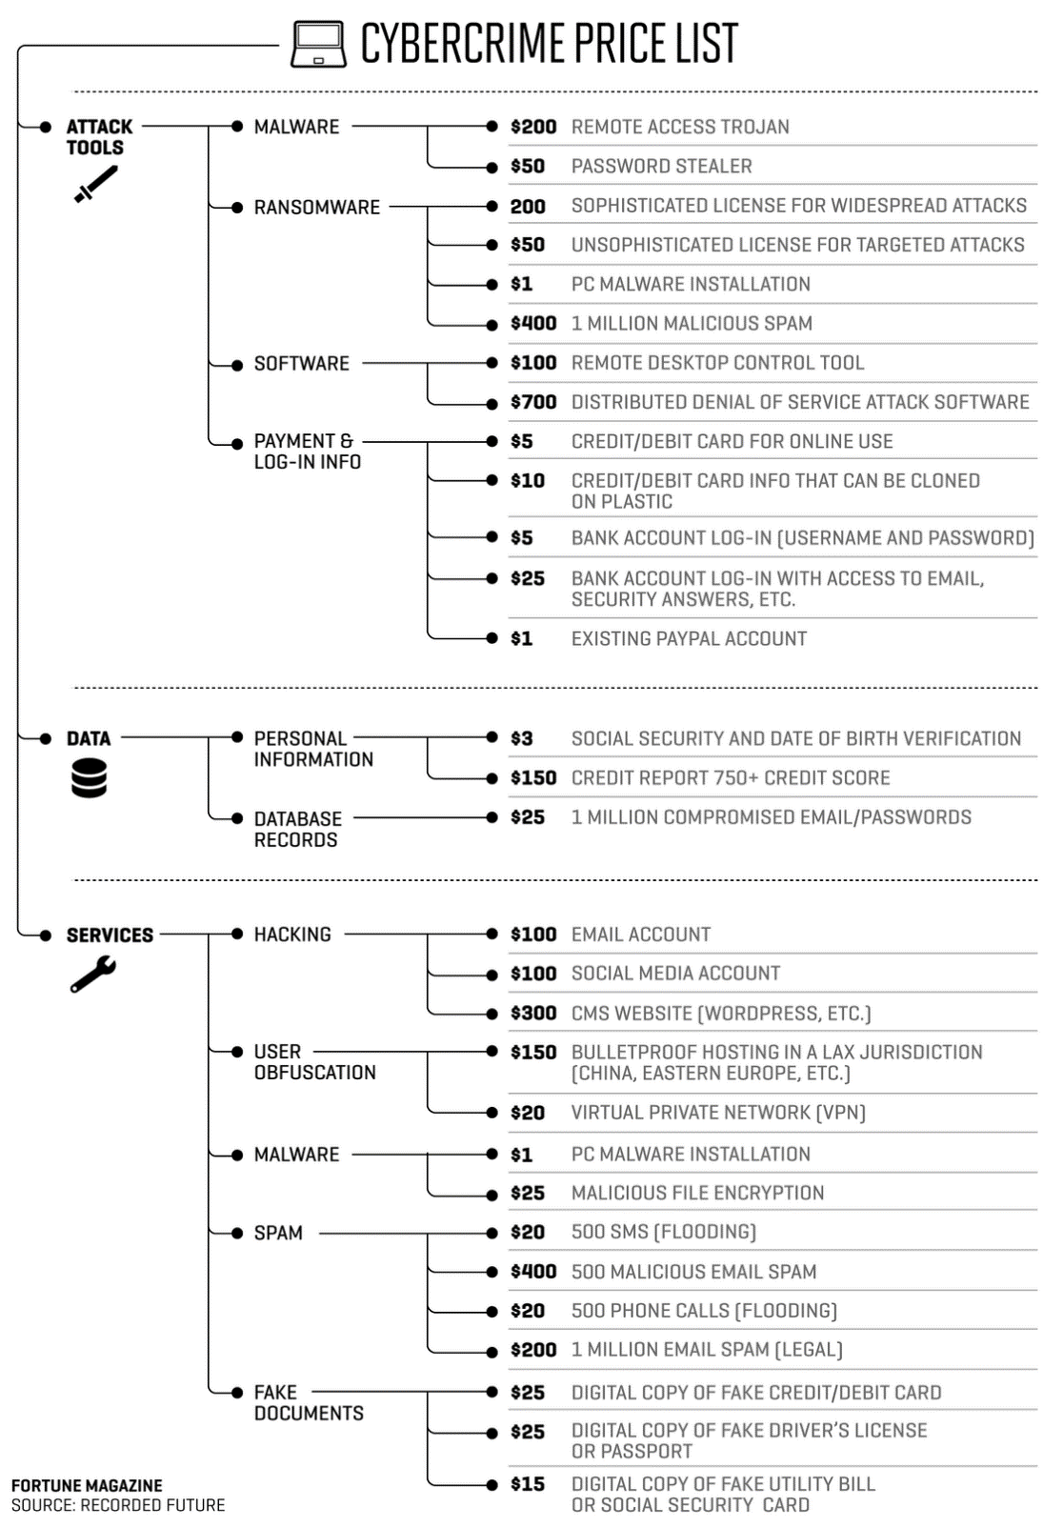
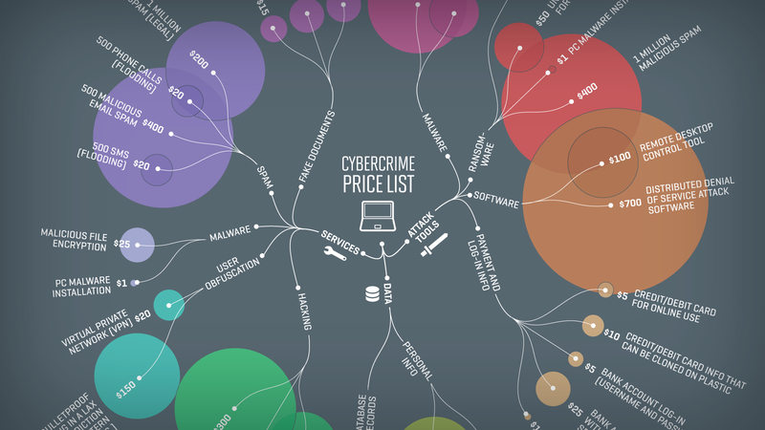
Phishing –
Lucrative Payoff
Notes:
These are price lists showing the value of stolen data and information on the dark web. CLICK when we look at it from these perspectives, it reaffirms our position that cybercrime is lucrative and not going anywhere. They’re so organized the know the value of a credit report that is (CLICK) 750 or higher, for example.

Slide 12
Threat Vectors
How The Bad Guys Get In
Notes:
Whether a big or small business, how are the bad guys getting in?

Slide 13
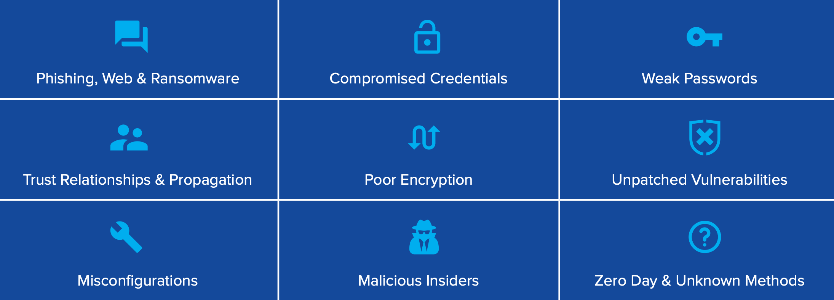
Threat Vectors
(How The Bad Guys Get In)
Notes:
Whether a big or small business, how are the bad guys getting in? The good news is that most of these threat vectors will be addressed in our training today.

Slide 14

Phishing – How it Works
Watch this four minute video! https://www.youtube.com/watch?v=4gR562GW7TI&t=108s (in the weblinks from today’s training).
Notes:
Here’s a great short video that will help this come alive for you – let’s see how easy this is.

Slide 15
Your Role
Protecting Yourself, Your Family, and Your Employer
Notes:
So, now that you understand WHY cybercrime is exploding and important to understand, WHO their targets are, HOW they do it – let’s take a peak at WHAT you can do to help prevent it.

Slide 16
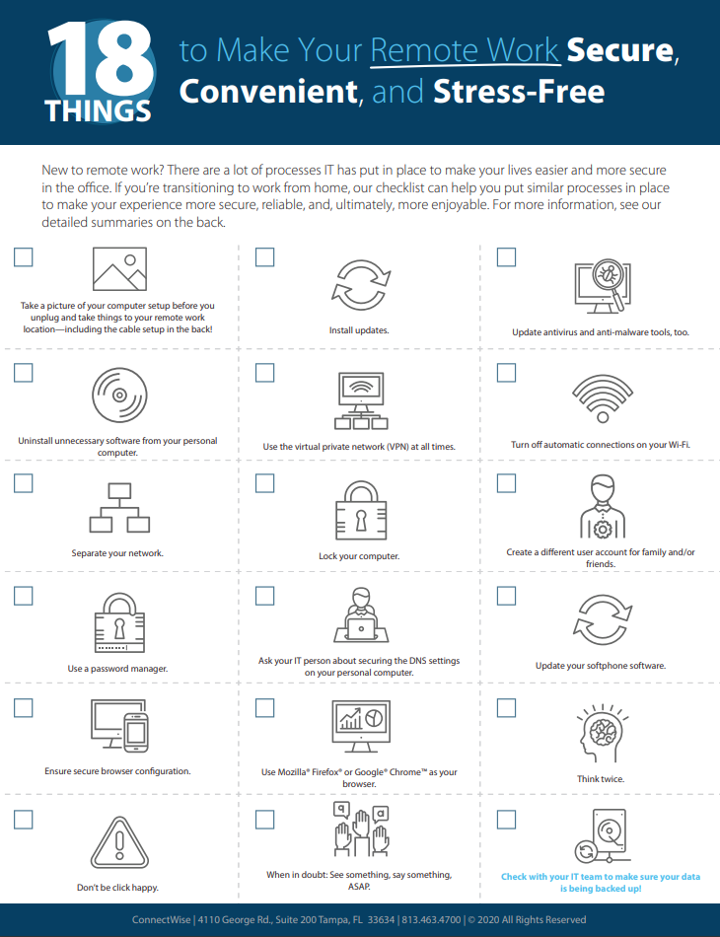
Our Checklist

Slide 17
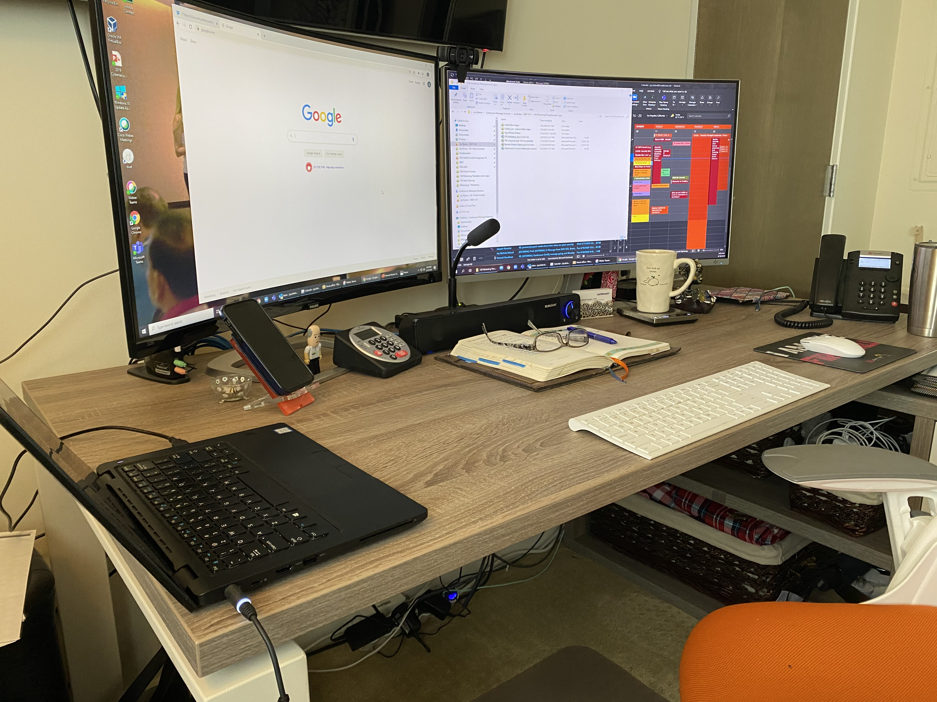
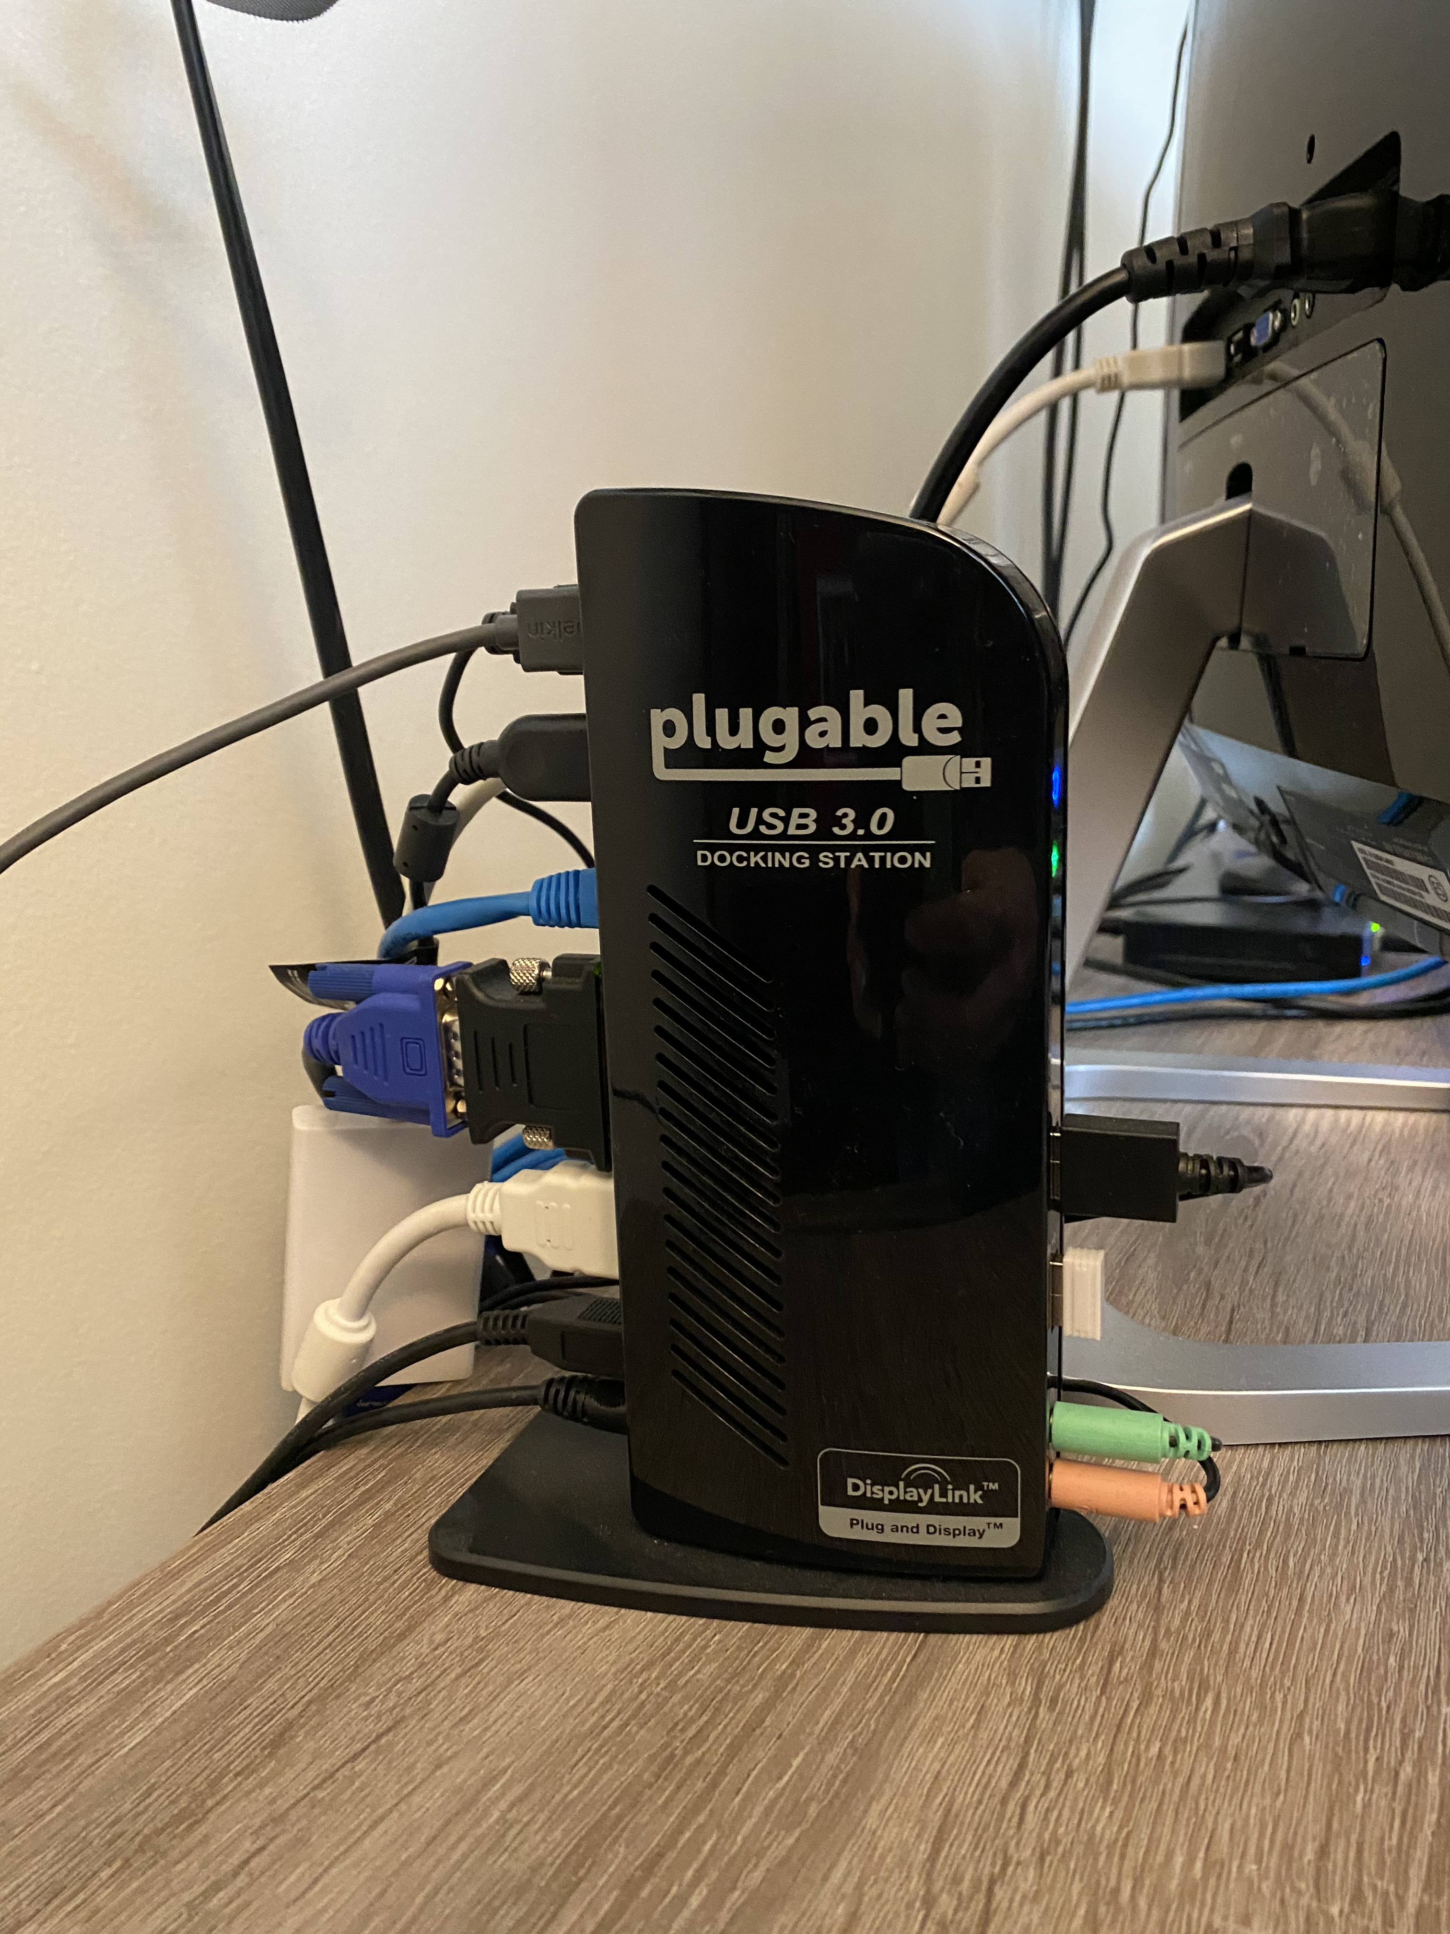
Your Home Office Setup
Take a photo of your work environment including the hookups of the equipment, so you know how to re-plug everything in at home.
Be sure to bring a power strip if you don’t have one at home.
Clean all equipment with antibacterial wipes before transport and after unpacking/setting it back up again at home.
What is your background like if you’ll be on camera?
Are you dressed for success? At home clothing may be too casual to continue conducting business. Consider dressing for work each day.
Notes:
Now some of this you’ve already done if you are working remotely with company equipment, but if not, we’ll start from the top. (read each one).

Slide 18
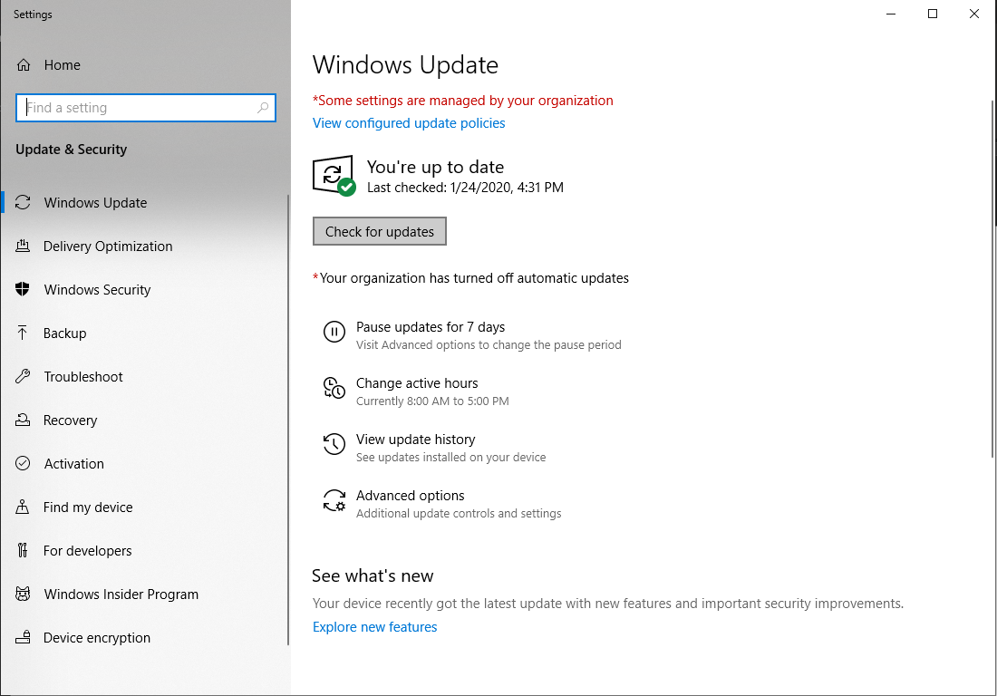
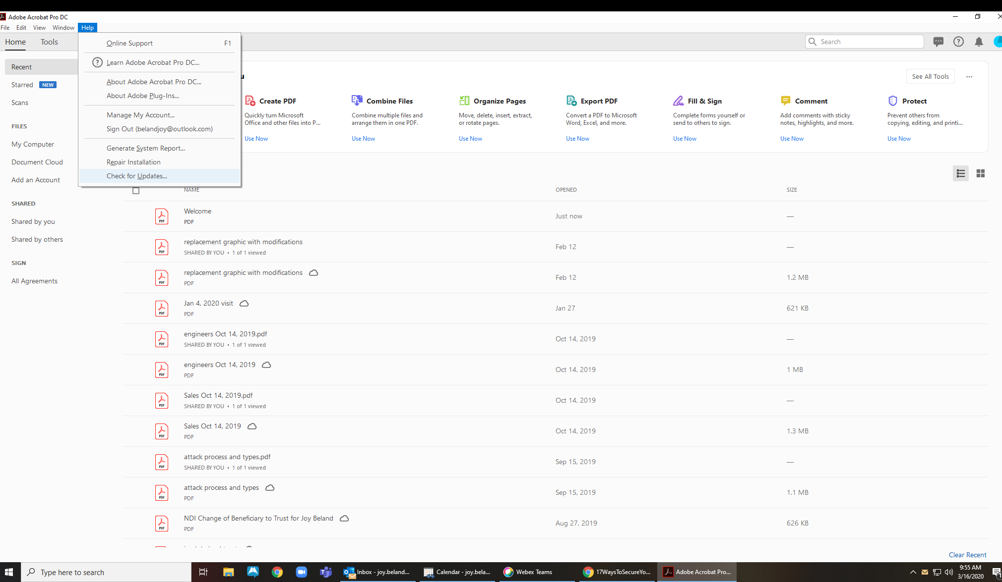
Install Updates
Windows Updates – hit the Win key and type “update” and you’ll see the “Check for Updates” option at the top of the Start Menu. Select that. You’ll see if your system is up to date, or where to initiate the Check for Updates here.
If you need updates, close all programs before proceeding. You may need to restart your computer for the updates to take effect.
Software Updates – Most commonly Adobe, Microsoft Office (Word, Outlook, etc).
Most programs allow you to open and select “check for updates” from the Help menu.
Once the update initializes, close the program so the installation can complete. You may need to restart your computer when the update is done.
Notes:
I’m using a PC in this example, but you’ll want to do the same if you have a mac. As I walk through instructions, I’m giving the shortcut to get to where you need to go, often using the Win key on the keyboard to pull up the settings we are referring to. (read one, two). CLICK you want to update your software, too. (read through)

Slide 19
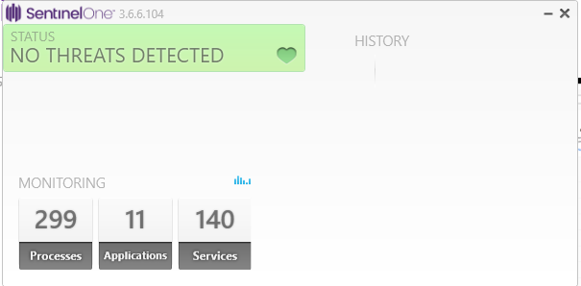
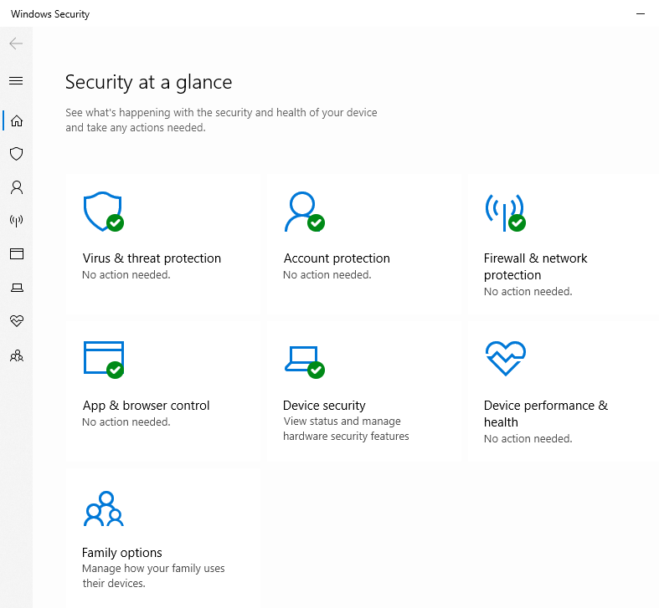
Update Anti-Virus and Anti-Malware
We recommend you have a paid, subscription-based AV program, make sure it shows the most current version running. It may have a “Check for Updates” button to click, or it should say “Your program is up-to-date.”
If you have a PC, go to the Windows Security Screen by hitting the Win button on the keyboard and typing “windows security” – it will be at the top of the start menu.
Any items not updated properly will have a red mark indicating it needs attention.
Notes:
You should be using a paid version of anti-virus or anti-malware, and it’s easy enough to make sure it is properly updating. In my example, I know that the version number at the top aligns with what my IT pro told me I need to be running. But most versions of antivirus will have a button that asks you to check for updates, or will tell you if it is up to date. CLICK In windows, there’s an overall security settings view that will be helpful. (walk through).

Slide 20
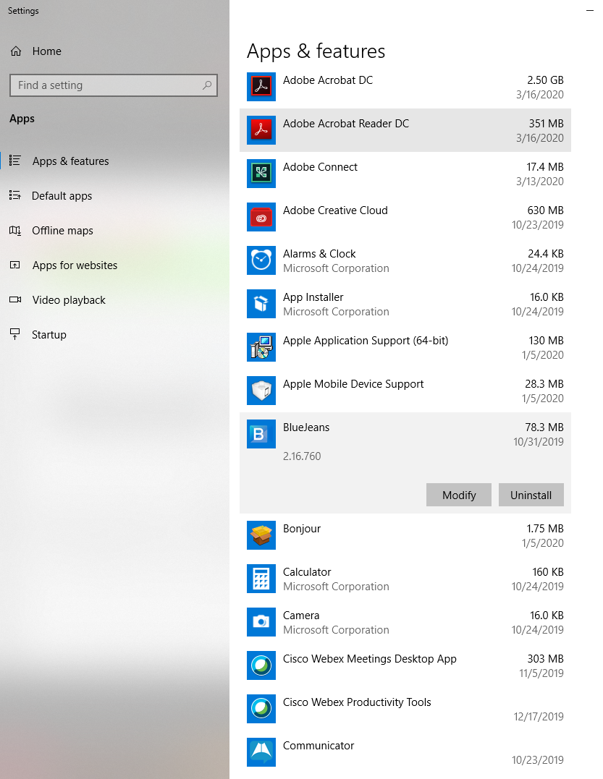
Uninstall Unnecessary Software
Using the Win key on your keyboard, type “programs” and the “Add or Remove Programs” option will come up to the top of the Start Menu.
In my case, I saw that I had a few programs that I no longer need. If you click on each program, you get the option to Modify or Uninstall. I Uninstalled Blue Jeans and Communicator.
If you’re uncertain which programs are safe to uninstall, ask your IT person for assistance.

Slide 21
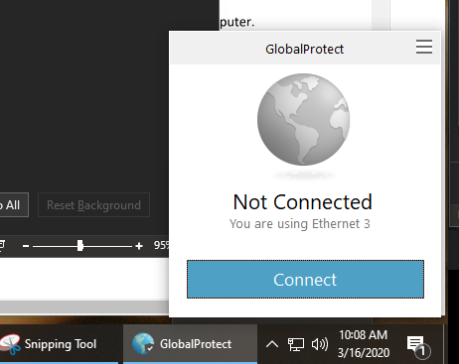
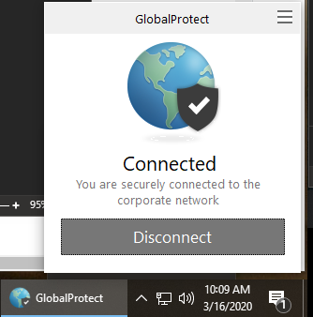
Connecting to the Company VPN
What is a VPN? It’s a “Virtual Private Connection.” Essentially, it creates a private tunnel through the Internet for your computer to access company digital resources.
If Your Company Provides a VPN Connection, Obtain the Instructions Before You Leave the Office with the Equipment You’ll Need
Test the Setup and Connection Before You Start Working on Company Data from the Home Computer
Shutting Down or Restarting Your Computer will Disconnect the VPN. Your IT Person May Have Specific Instructions on the Disconnect Procedure for You.

Slide 22
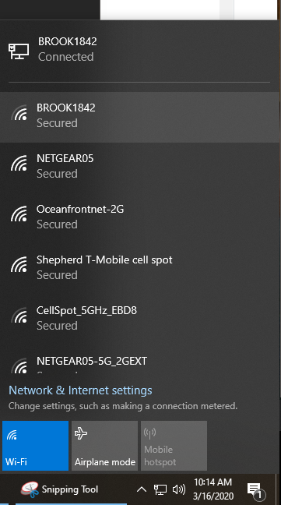
Turn Off Option to Automatically Connect on Wi-Fi
Look at each Wi-Fi connection you have used in the past. You might have selected a different, less secure signal (i.e. the Starbucks across the street) and checked “Connect Automatically.” That signal could be taking priority over a more secure signal you should be using.
If you are connected to the wrong signal, click on it and select “Forget this Network.” That will force your computer to sign into that network manually next time.
Connect to the most secure network you can, at all times. We recommend you NEVER connect to a network that is not password protected, even if you’re using a VPN.

Slide 23
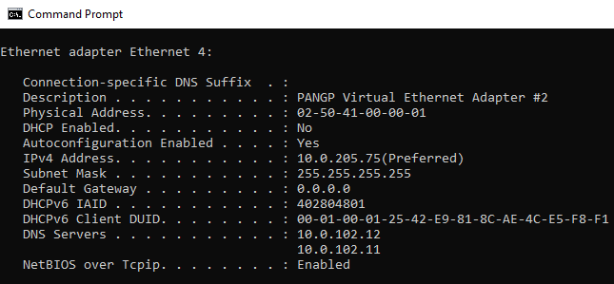
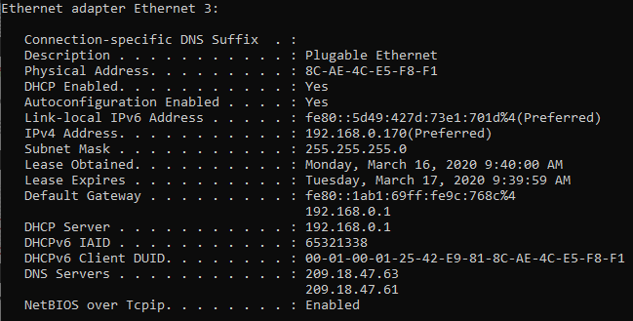
Separate Your Network
If you’re working from home and have the ability to set up two networks on your router, configure one for your computer and another segment for all other devices.
Suggest to name differently, like WR32B-DEV for all other devices, and WR32B for your computer. That way it’s easy enough for you to remember which one your computer is joined to.
Ask your IT person for help setting this up, if you need assistance.

Slide 24
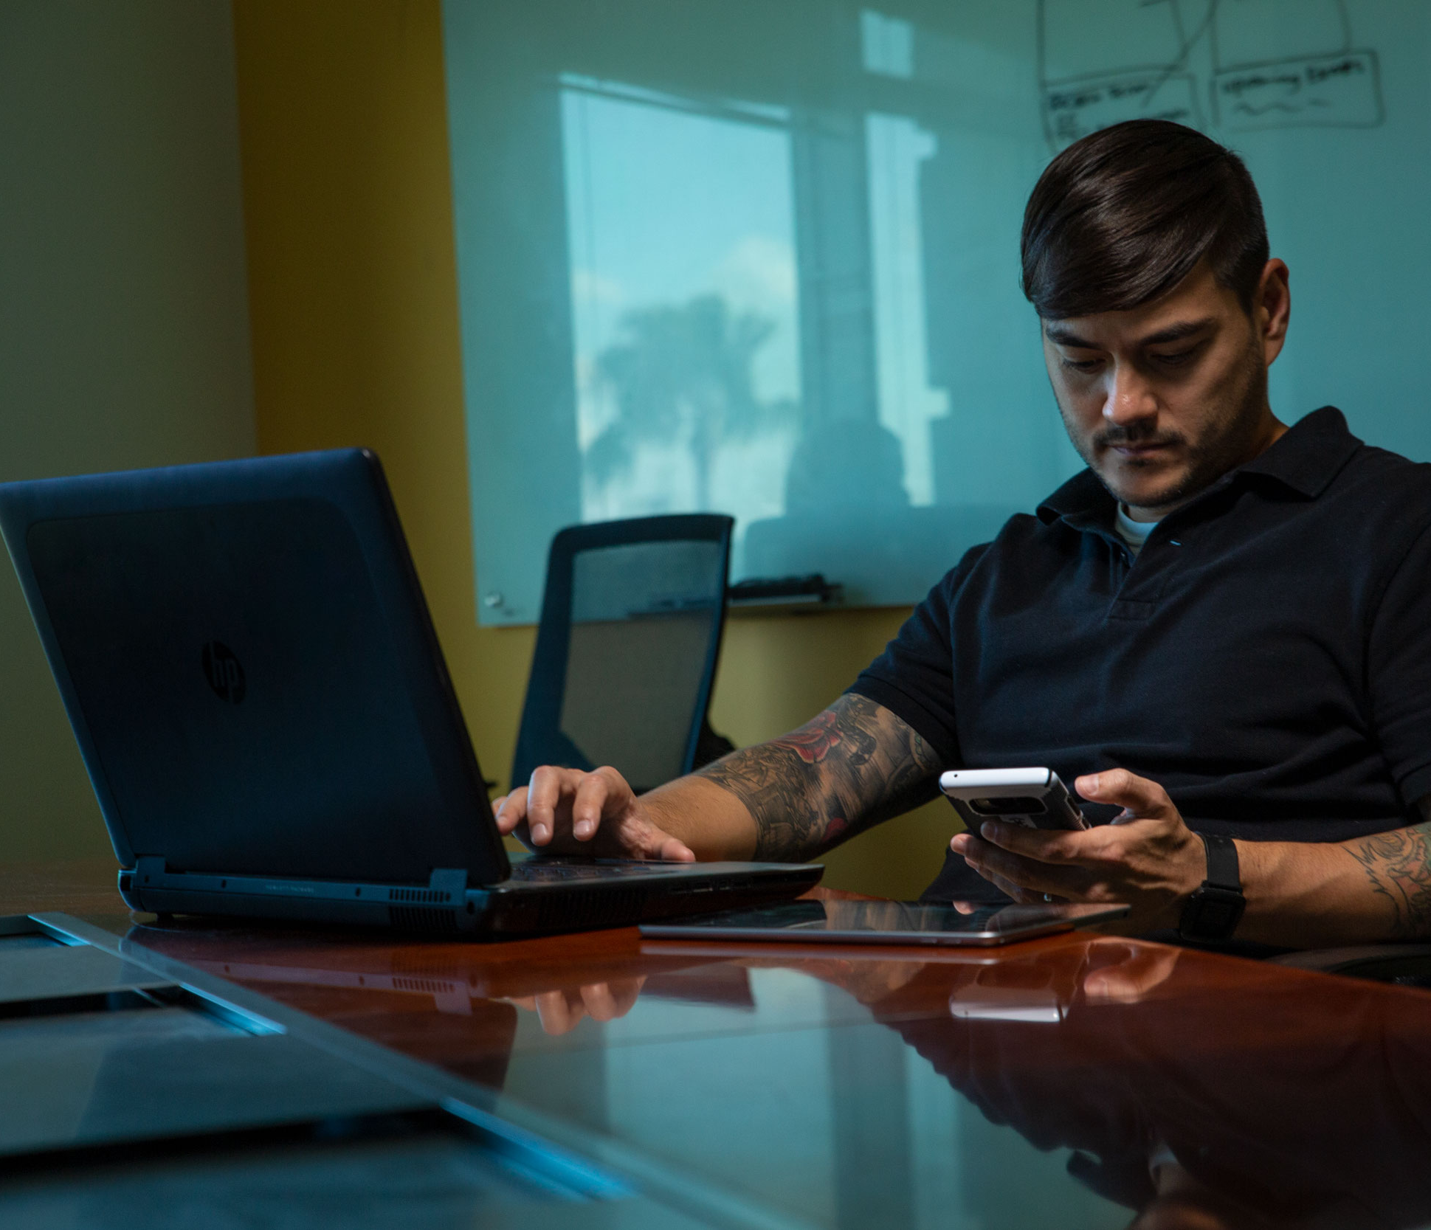
Lock Your Computer When Not in Use
Especially Important if You Work Remotely in a Public Area, Like a Starbucks
Important if You Have Children or Spouses Around
What is Private at Work Should be Treated as Private Remotely

Slide 25
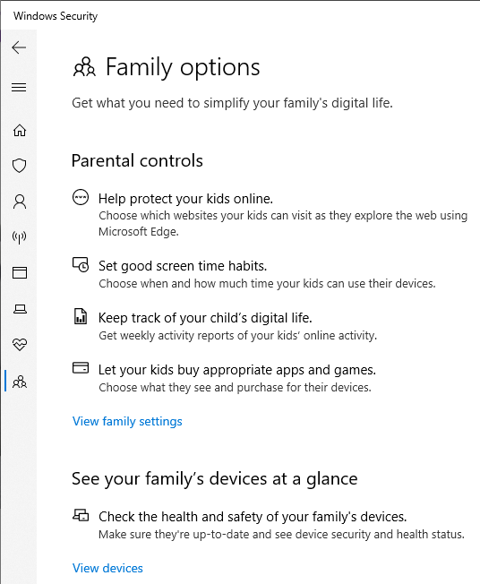
Create a Separate User Profile
It’s preferred to dedicate one computer to working remotely (not shared with spouse or children).
If you need to share computers, be sure to set up separate User Profiles, and enable Parental Controls on the children’s User Profiles.
Remember this rule of thumb – if it’s free, it probably has spyware on it. If you don’t need it, don’t install it.

Slide 26
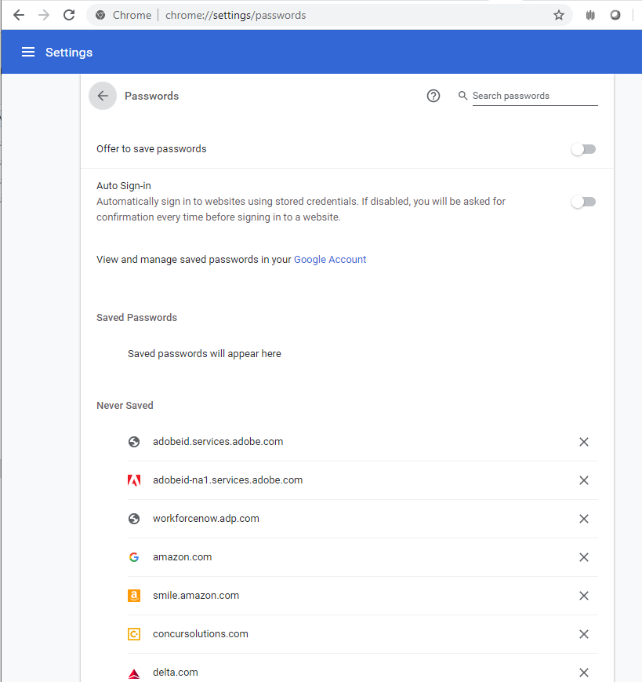
Got Passwords?
Use a password manager to save them. Some examples: Password Boss, Passportal, LastPass, Dashlane, 1Password, KeeperMSP, etc.
Never allow your browser to save passwords or to auto-login.
Never save your passwords in a Word or Excel document on your computer. If you MUST do so, do not name it “Passwords,” name it something like “Mom’s Chicken Soup Recipe” and do not use the word “password” anywhere in the document itself (it will show up in a search). And password-protect that document, so if someone else tries to open it, they can’t do so without the password.

Slide 27
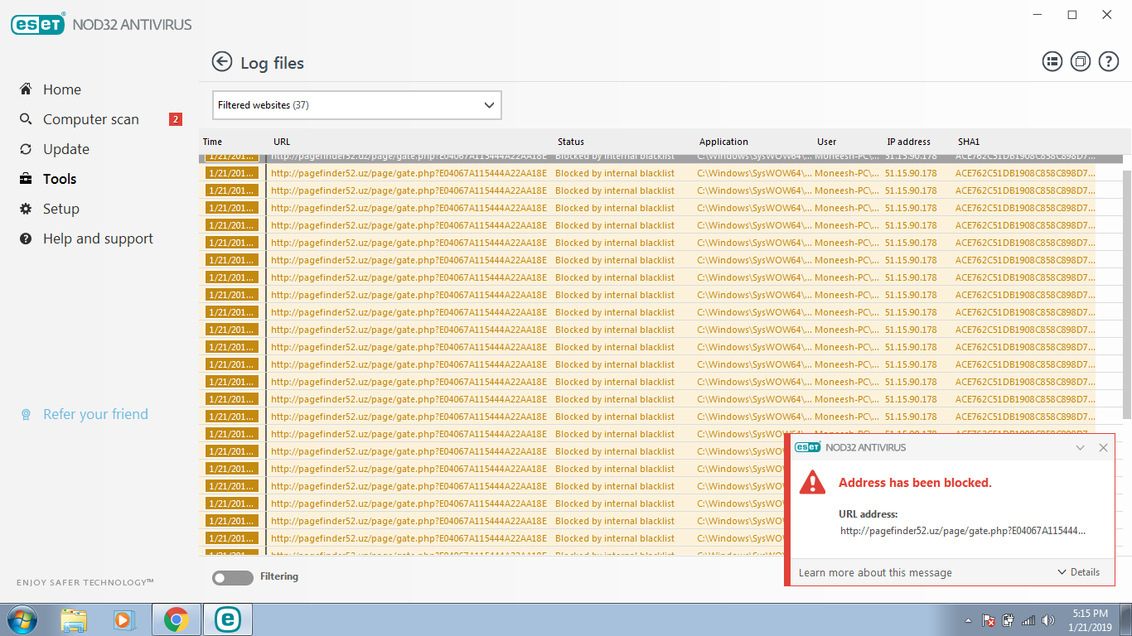
Use a DNS Filter
What is DNS? It’s essentially a phone book of all known domains and matching “addresses” for the internet. It contains every website domain, whether it is malicious or reputable.
There are security solutions that subscribe to a list of known bad domains. They are called DNS filters. When you try to click on a website URL or do an internet search, a DNS filter will block a malicious website in most cases.
Check with your IT provider to see if they have something you can install on your home computer to serve this purpose.

Slide 28
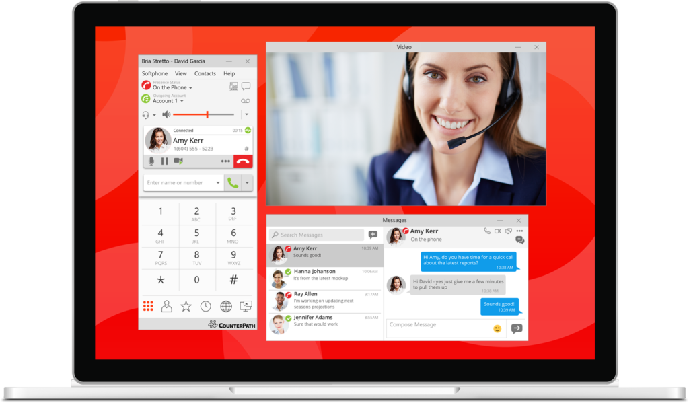
Update Your Soft Phones or Remote Software Tools
If you have access to a Soft Phone or Teams based tools for remote work, check with your IT Team before you set it up, to make sure it has been secured properly.
Keep in mind that internet bandwidth might be affected – most VoIP and remote tools protect a portion of the internet bandwidth for the data packets used in voice and video calls. Your internet browsing, upload and download speeds may be affected. Or your call quality.

Slide 29
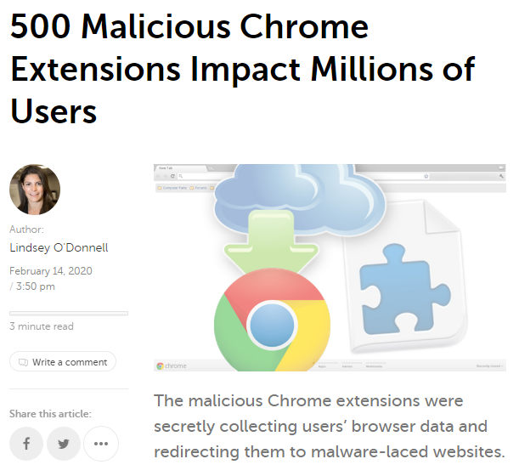
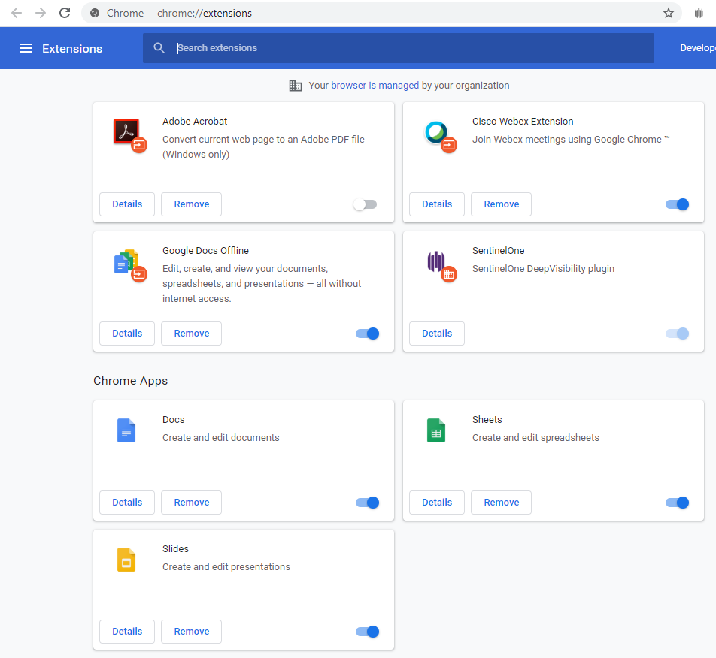
Uninstall Google Chrome Extensions
We get it, if you use it, you might need it. But if you’re not using an extension, it’s good to uninstall it. Many of the extensions created years ago and posted in the Google Chrome Extension library, had been sold to malicious actors, or are no longer supported.

Slide 30
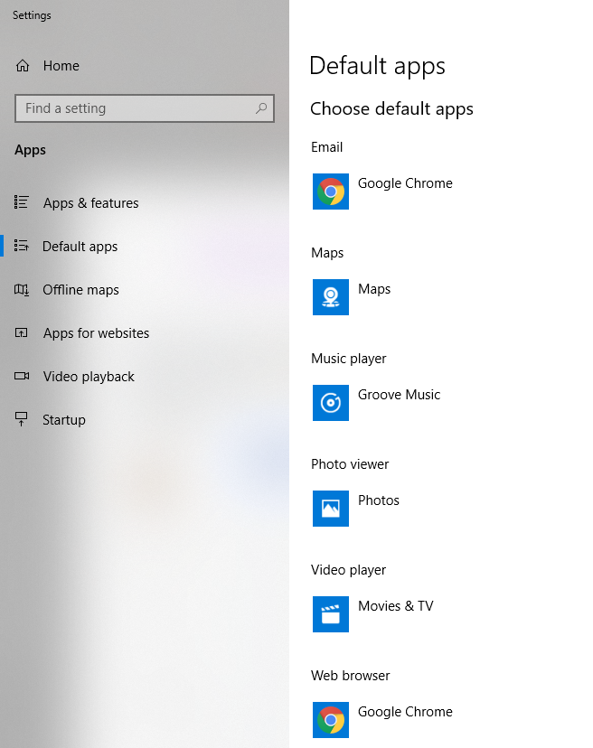
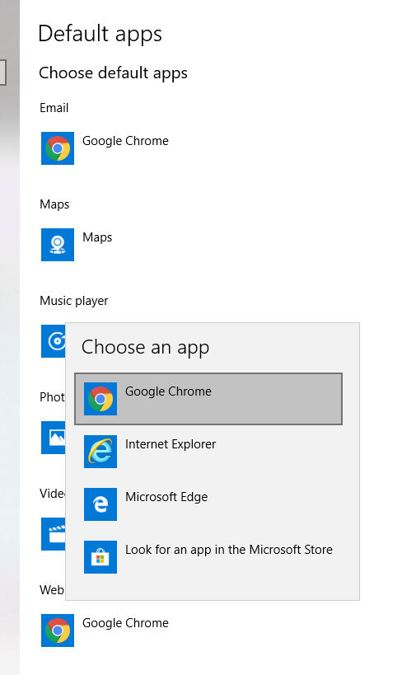
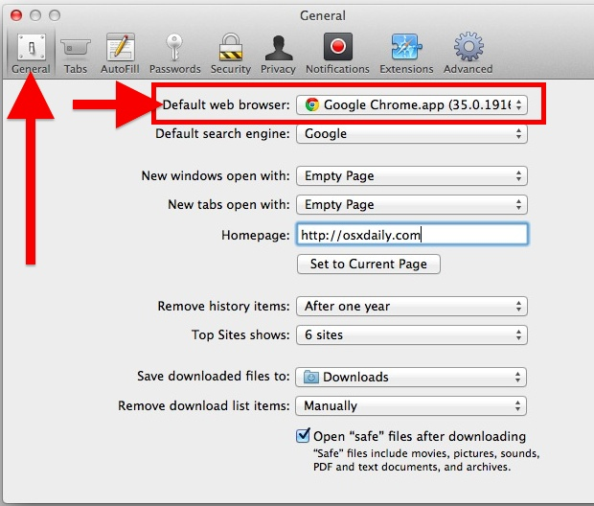
Use Google Chrome or Firefox to Browse
Default browsers (whether it’s Internet Explorer for the PC, or Safari for the Mac) are not as secure as Google Chrome or Firefox.
After you install an alternate browser, change the default browser selection:
  PC – click the Win key and type “Default” then select “Default Apps” from the top of the Start Menu. Scroll down to Web Browser and Select Chrome or Firefox.
  Mac – In Preferences, go to the General tab and Use the Drop Down menu to select Chrome or Firefox.

Slide 31
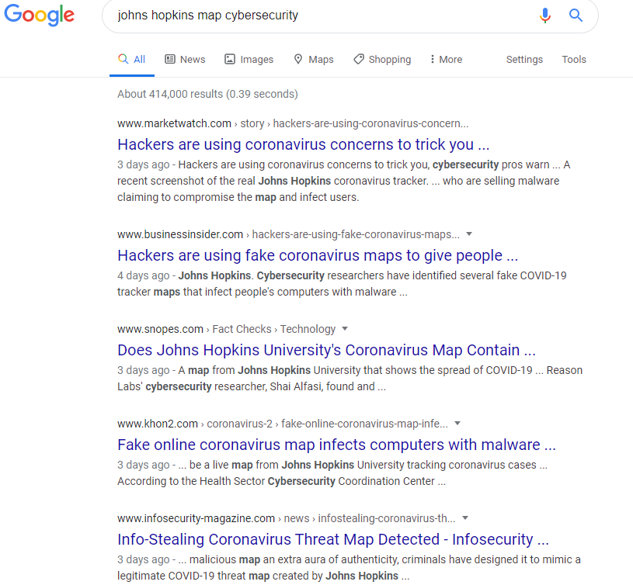
Think Twice
You’re in an unfamiliar environment for working on company data. Don’t take anything for granted.
You might be tempted to mix in personal “computing” that you wouldn’t normally do during work. Is that music application, video link that your spouse emailed to you, etc. really important to open now?
Scouring the news for what’s happening world-wide and right in your own neighborhood might be important. But be careful what you click on! Take the time to do a safe web search.
Hackers know most people are not working behind their office firewall. They are actively seeking to exploit users and steal the company assets.

Slide 32
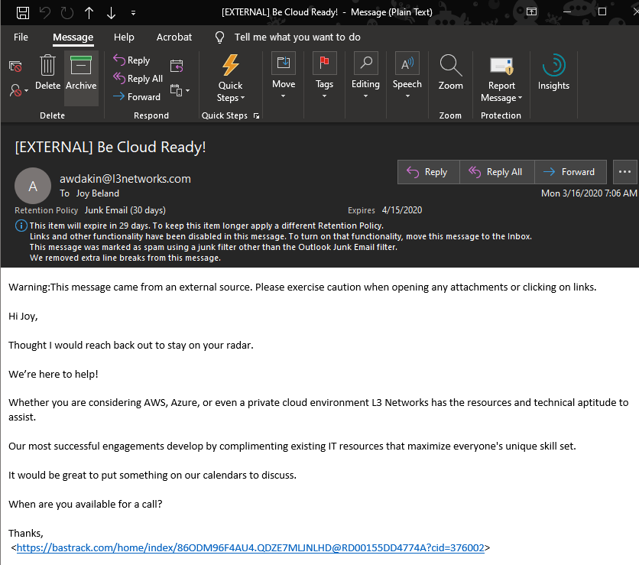
Don’t Be Click Happy
  Think About What You Might Not Have on Your Home Computer, That is Probably on Your Office Network:
  Office 365 Advanced Threat Protection which Serves as a Primary Filter for Infected or Malicious E-mails
  E-mail Filters Via (Vendor) for Infected Attachments and Known Malicious Links
  DNS Filtering for All Requests Sent From Your Computer to the Internet, Blocking Known Malicious Websites and IP Addresses
  Advanced Endpoint Protection Which Stops 99.9% of Ransomware Activity, as a Final Layer of Defense

Slide 33
See Something? Say Something
  If you receive a suspicious email, report it to your IT provider. Others may receive the same email and should know not to action on it.
  Using the Outlook application at the office, you might have a “Report Message” button that is not available when working on the webpage or a mobile device. Know who to forward the email to, so it can still be reported.
  Notice a big slow down in your system? It might just be the internet, or an update installing – or it might be something more nefarious. It’s okay to ask to get it checked out by IT.

Slide 34
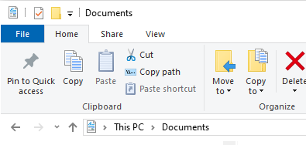
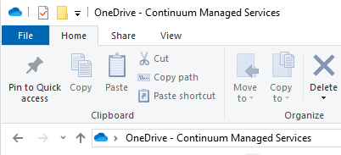
Data Backup
  Check with your IT Provider to see if data you create or modify is being backed up correctly.
    Cloud applications /repositories may have versioning (saves a copy of each version you work on, automatically) but may not be backed up in a separate location.
    Files you copy to your personal computer may represent a breach in confidentiality or policy. Understand how to access and save data correctly, to avoid any potential problems down the road.

Slide 35
Thank You
Please See Your IT Provider
with Questions and
Assistance.

